Slide 1

CSC 533: Privacy in the Digital Age (Fall 2020)
Lecture 14: Privacy Implications of ML Models
Anupam Das
Oct. 6, 2020

Slide 2
Goals:
Privacy risks with using machine learning techniques
Model inversion attack
Membership inference attack
Some slide contents have been taken from Vitaly Shmatikov and Matt Fredrikson

Slide 3
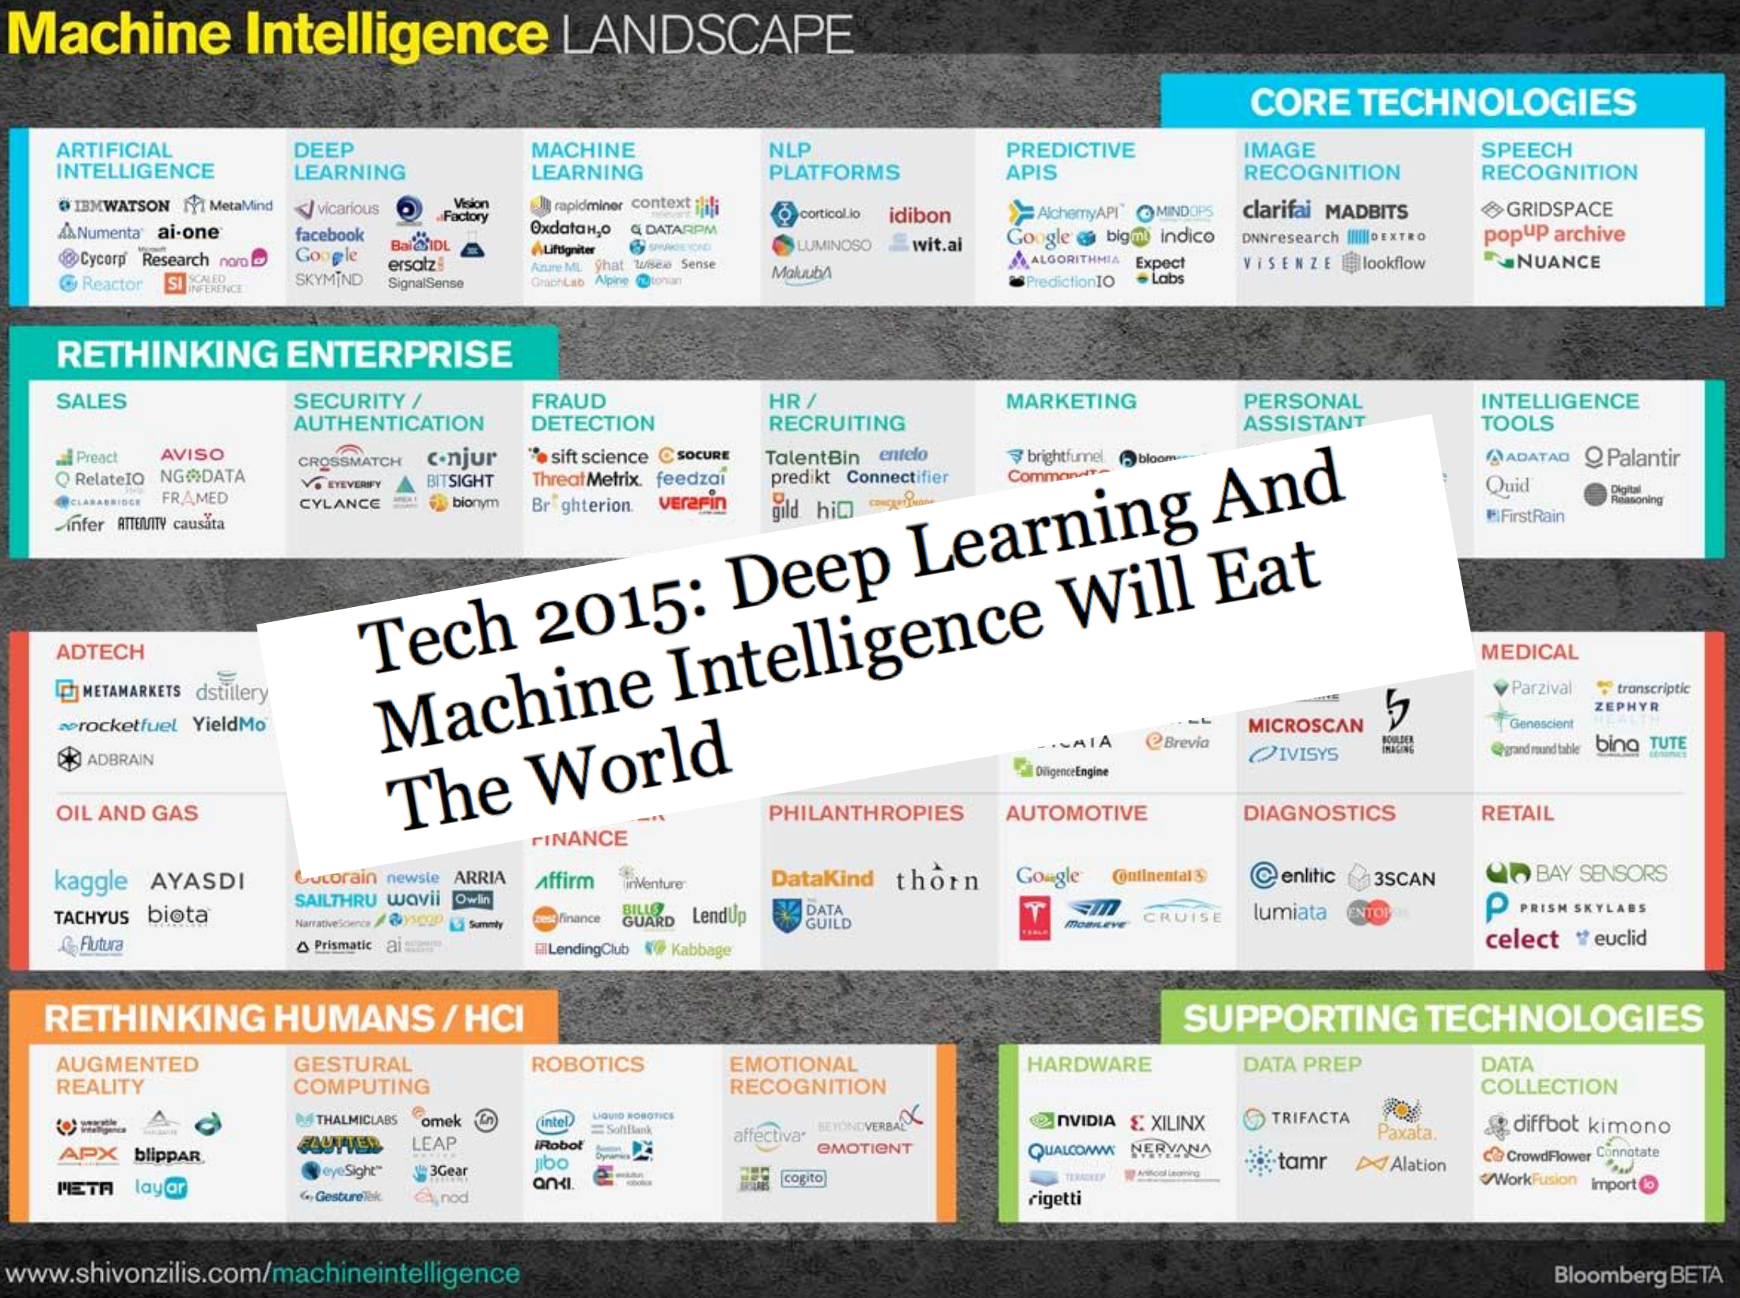
ML everywhere

Slide 4
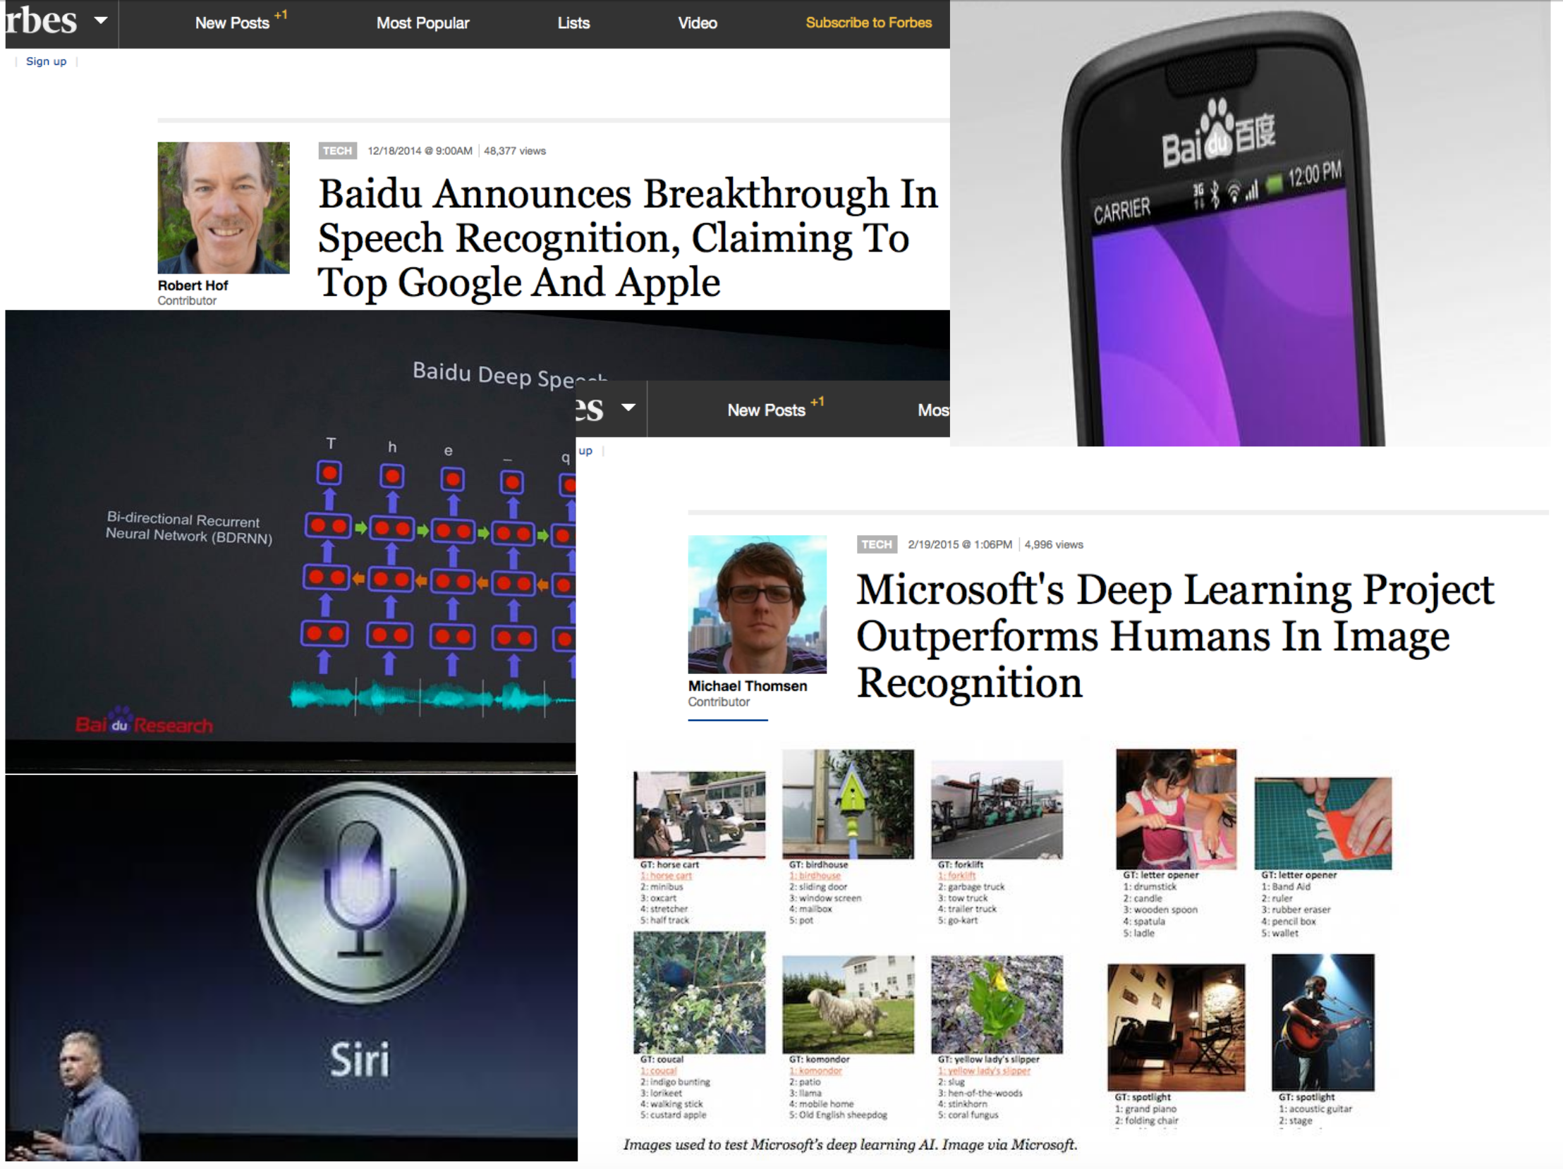
Still growing

Slide 5
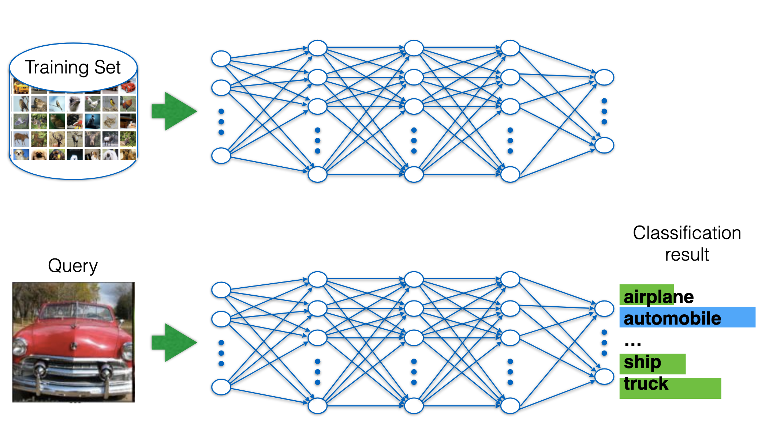
Typical task: Classification
Labeled data

Slide 6
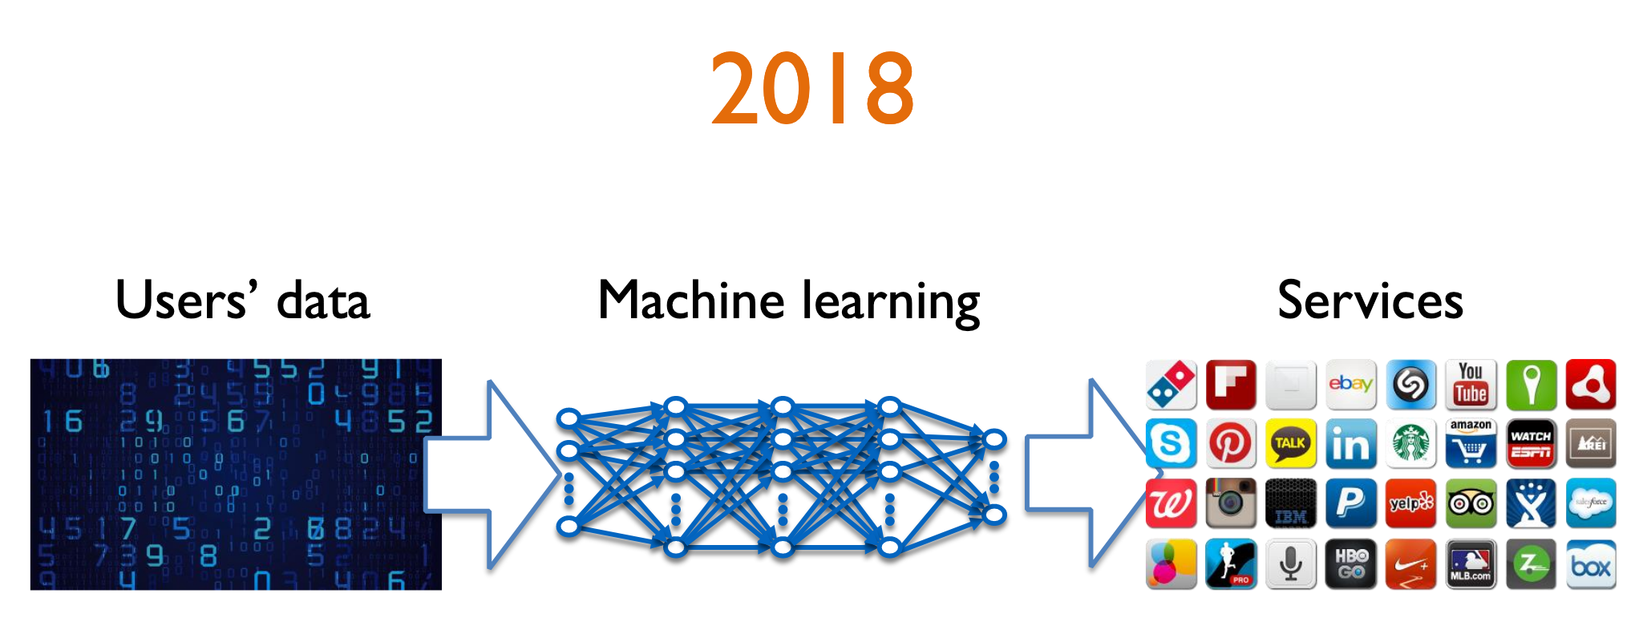
Privacy related questions
Do trained models leak sensitive data?
Is it possible to train a “good” model while respecting privacy of training data?
Is it possible to keep the model itself private?

Slide 7
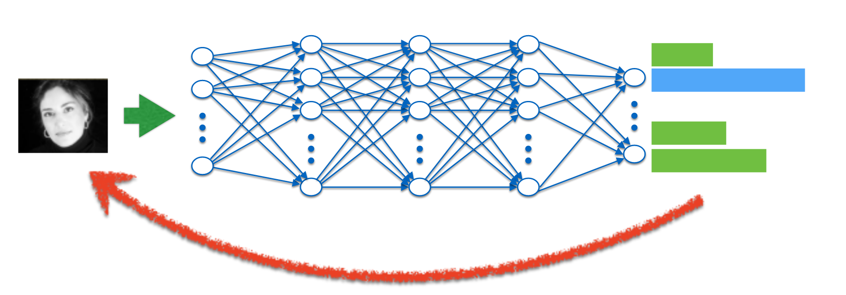
Model inversion attack
Given an output of a machine learning model, infer something about the input (e.g., sensitive feature of a user)

Slide 8
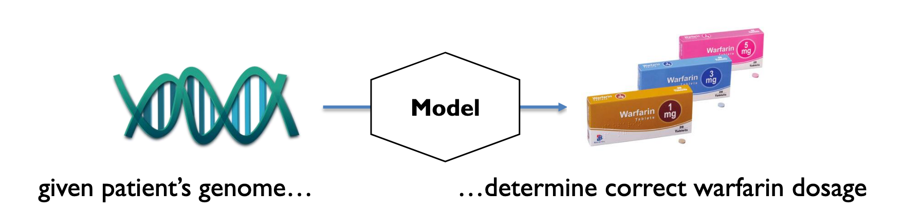
Model Inversion in Action
Privacy breach: given patient’s warfarin dosage, infer information about patient’s genome

Slide 9
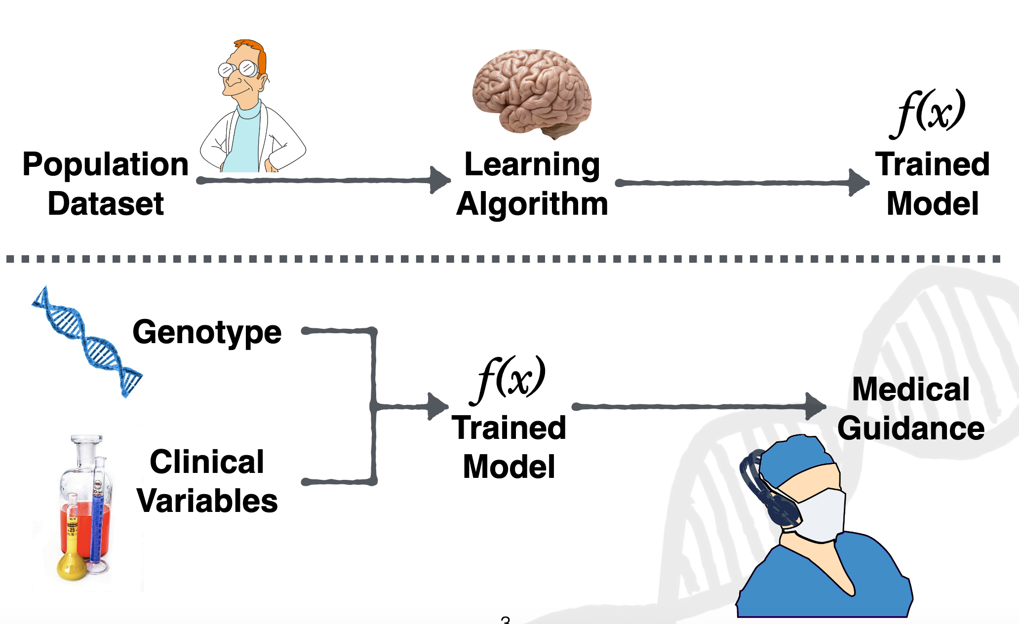
Pharmacogenetics

Slide 10
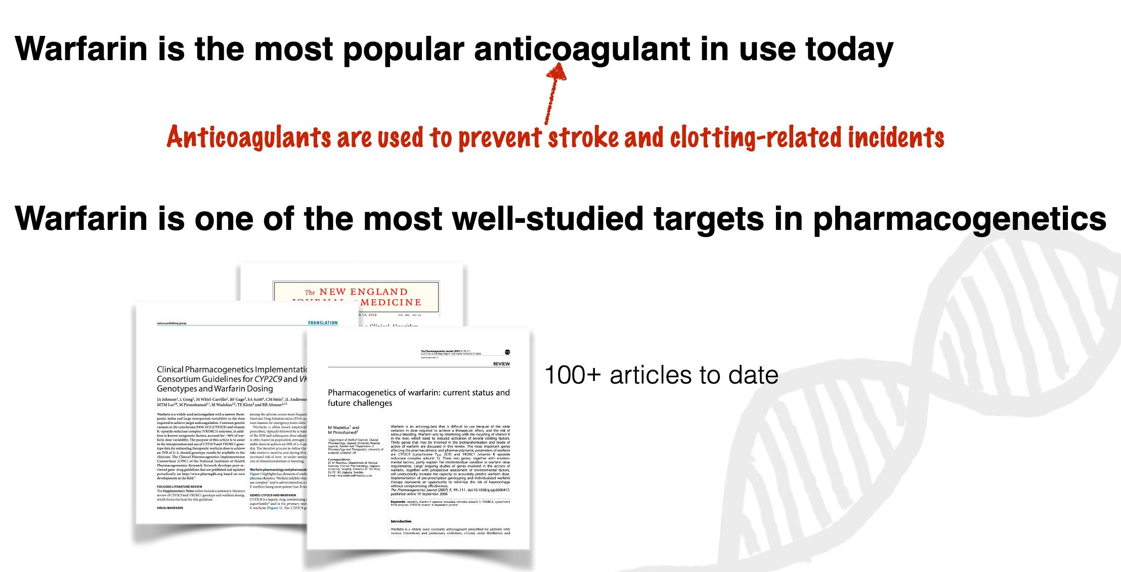
Warfarin dosing

Slide 11
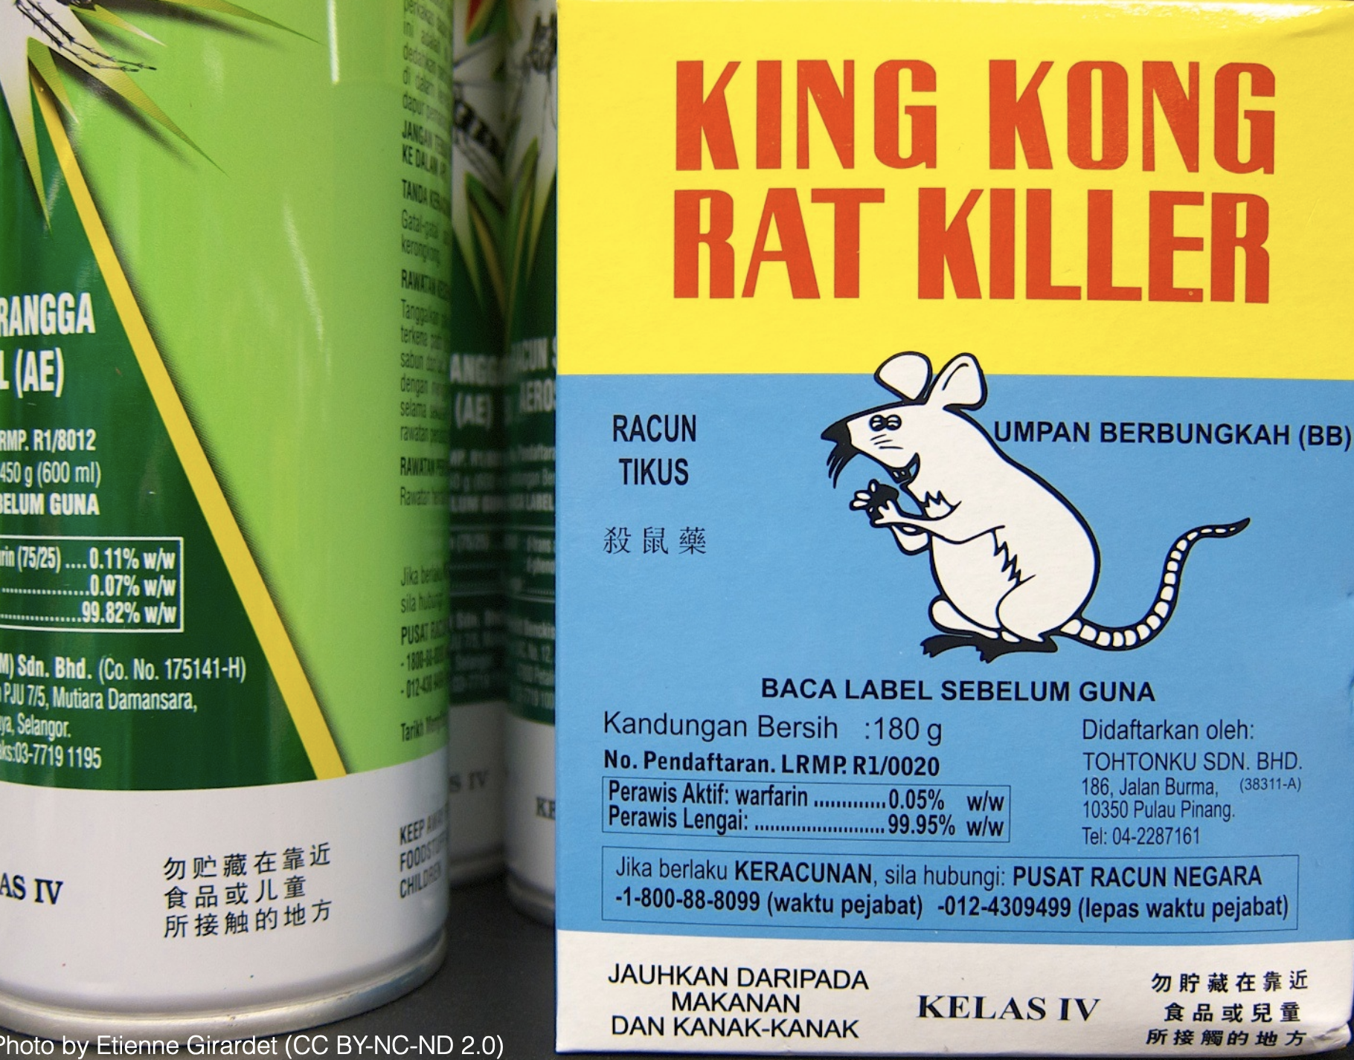
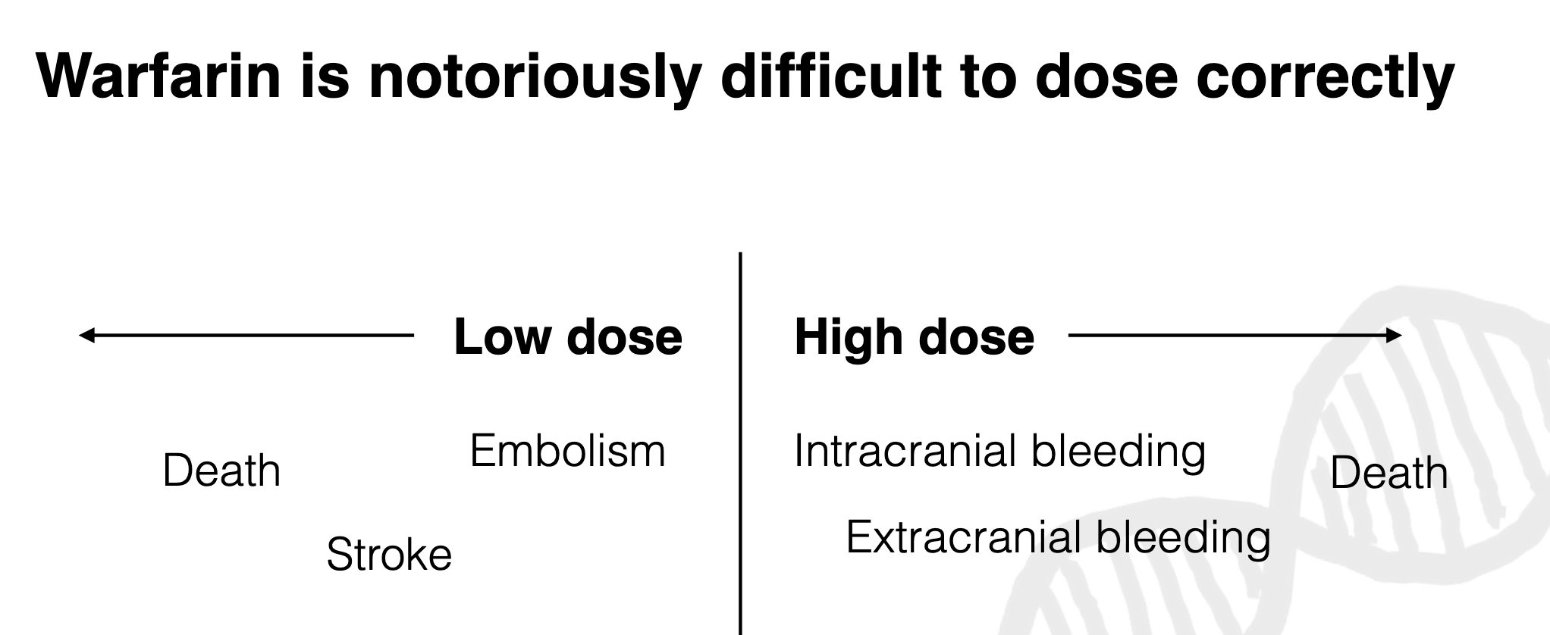
The dangers of being wrong
Warfarin is a tricky compound

Slide 12
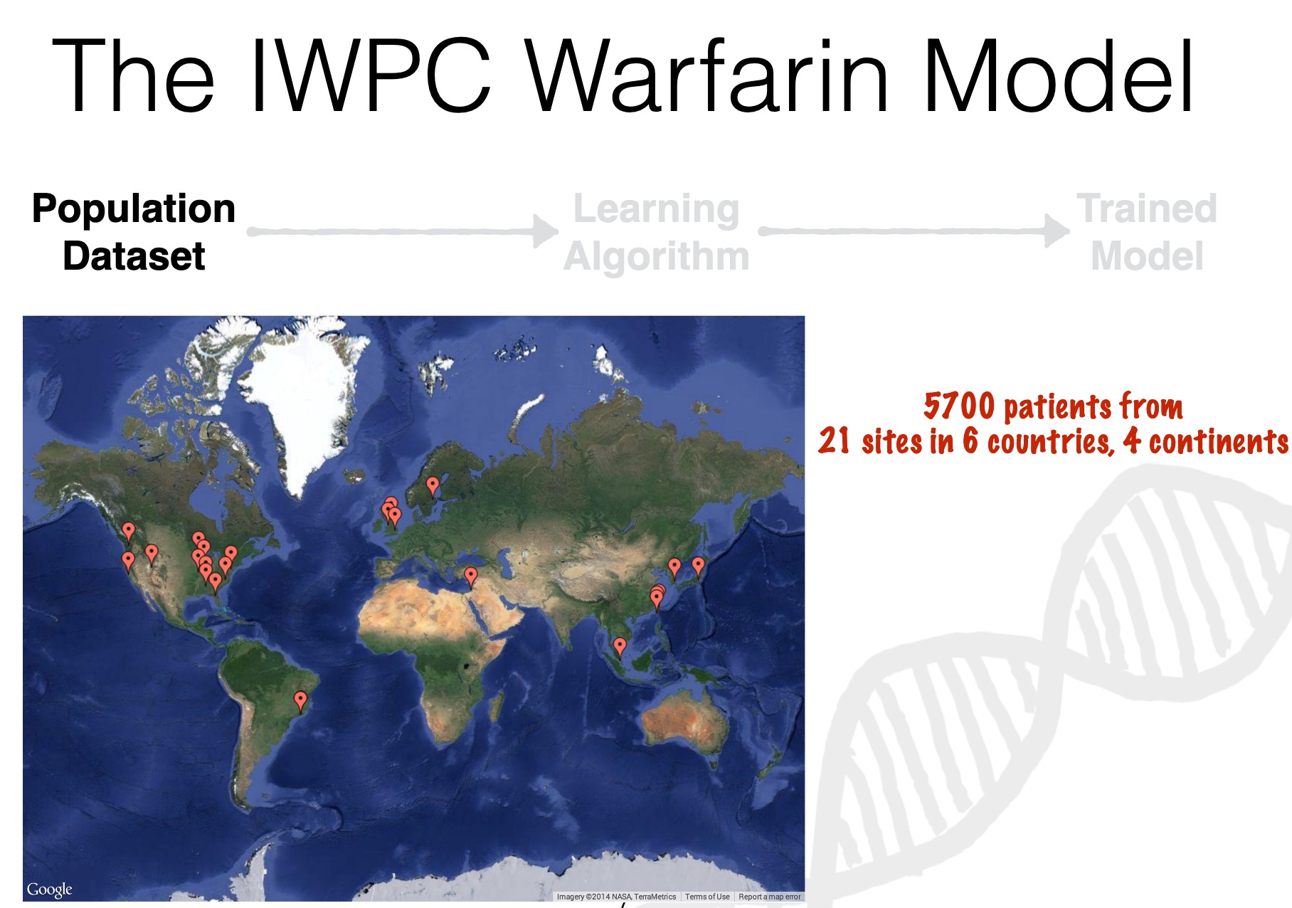
International Warfarin Pharmocogenetics Consortium (IWPC)

Slide 13
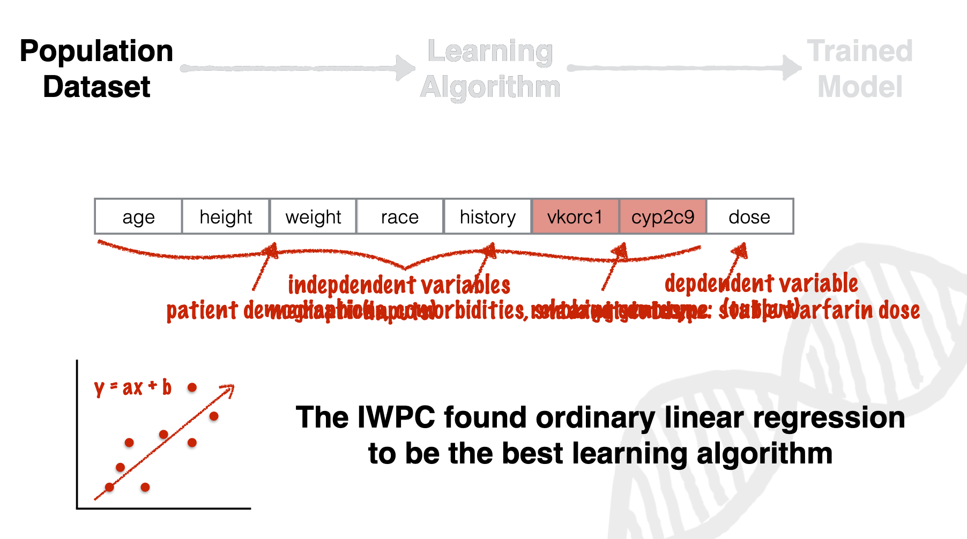
IWPC warfarin model
genotypes
Privacy in Pharmacogenetics: An End-to-End Case Study of Personalized Warfarin Dosing Matthew Fredrikson, Eric Lantz, and Somesh Jha, University of Wisconsin (USENIX 2014)

Slide 14
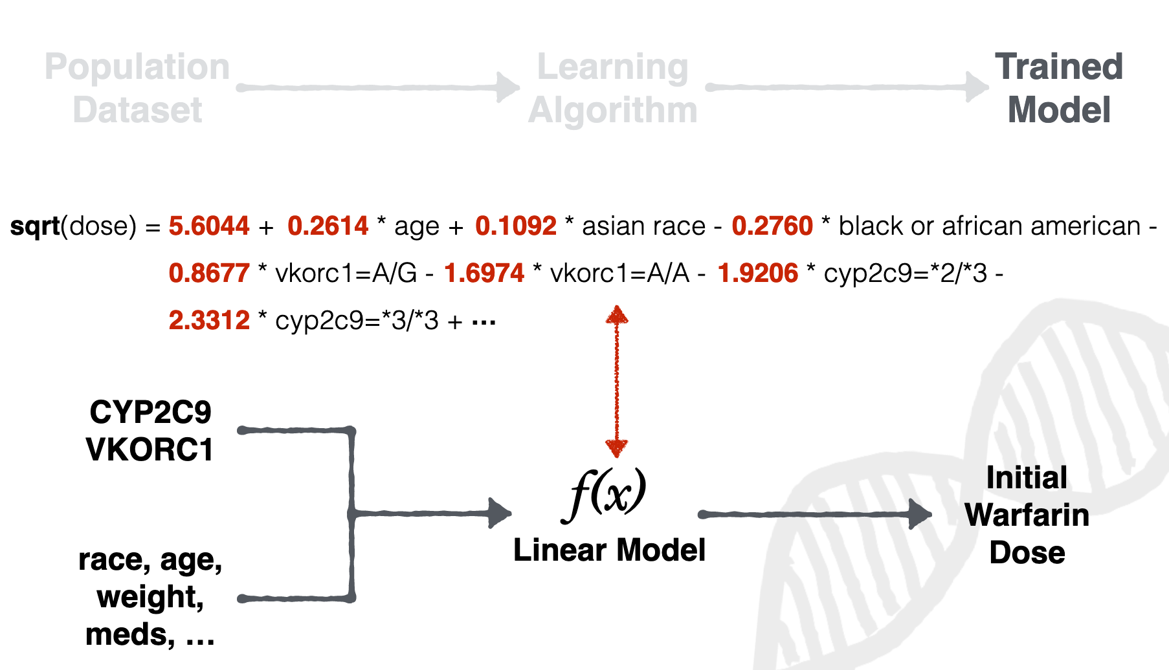
Pharmacogenetic Warfarin Dosing

Slide 15
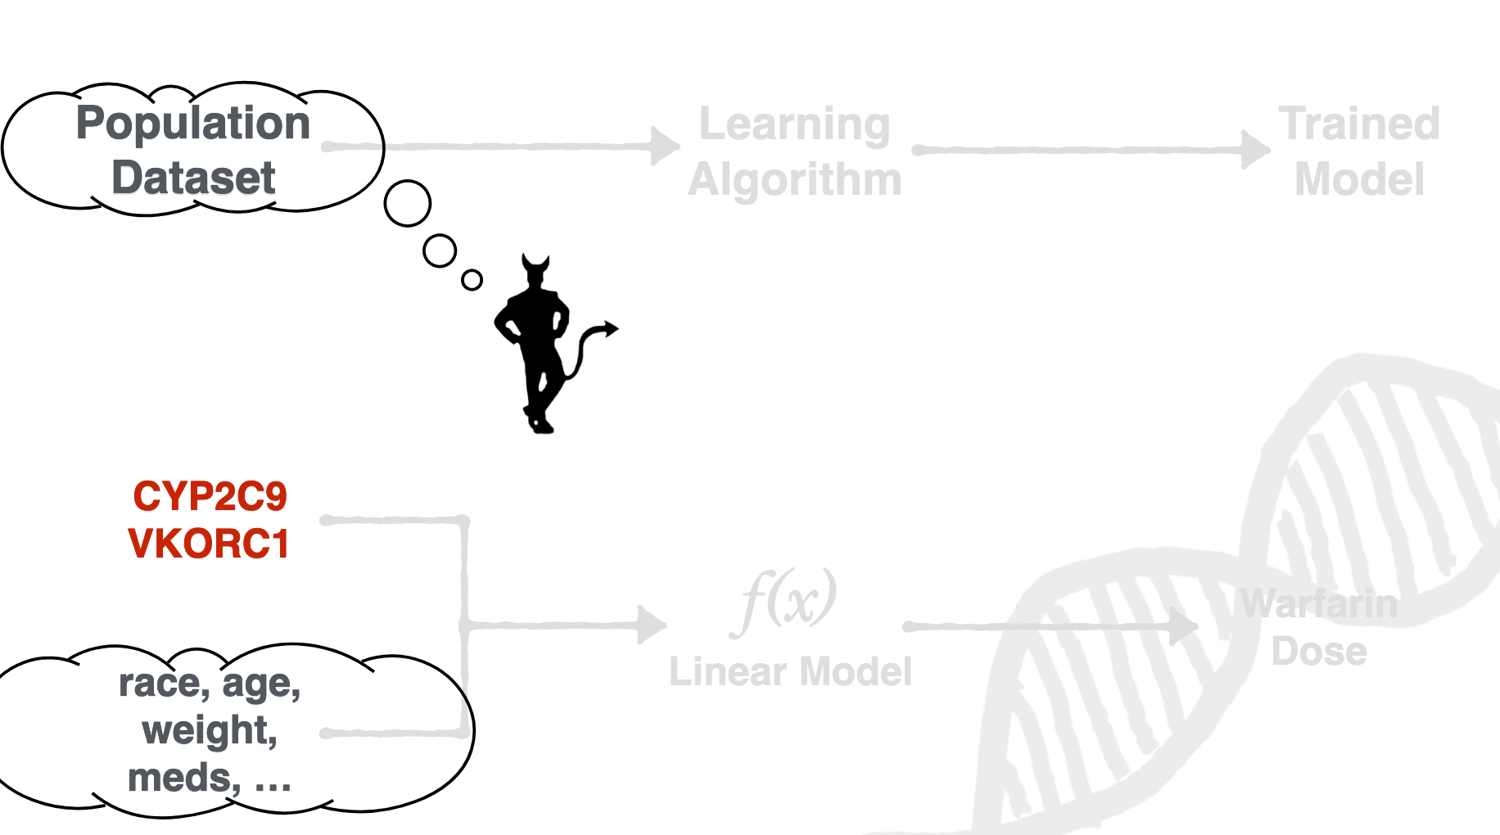
Pharmacogenetic Privacy
Not easily available data
Relatively easily available data

Slide 16
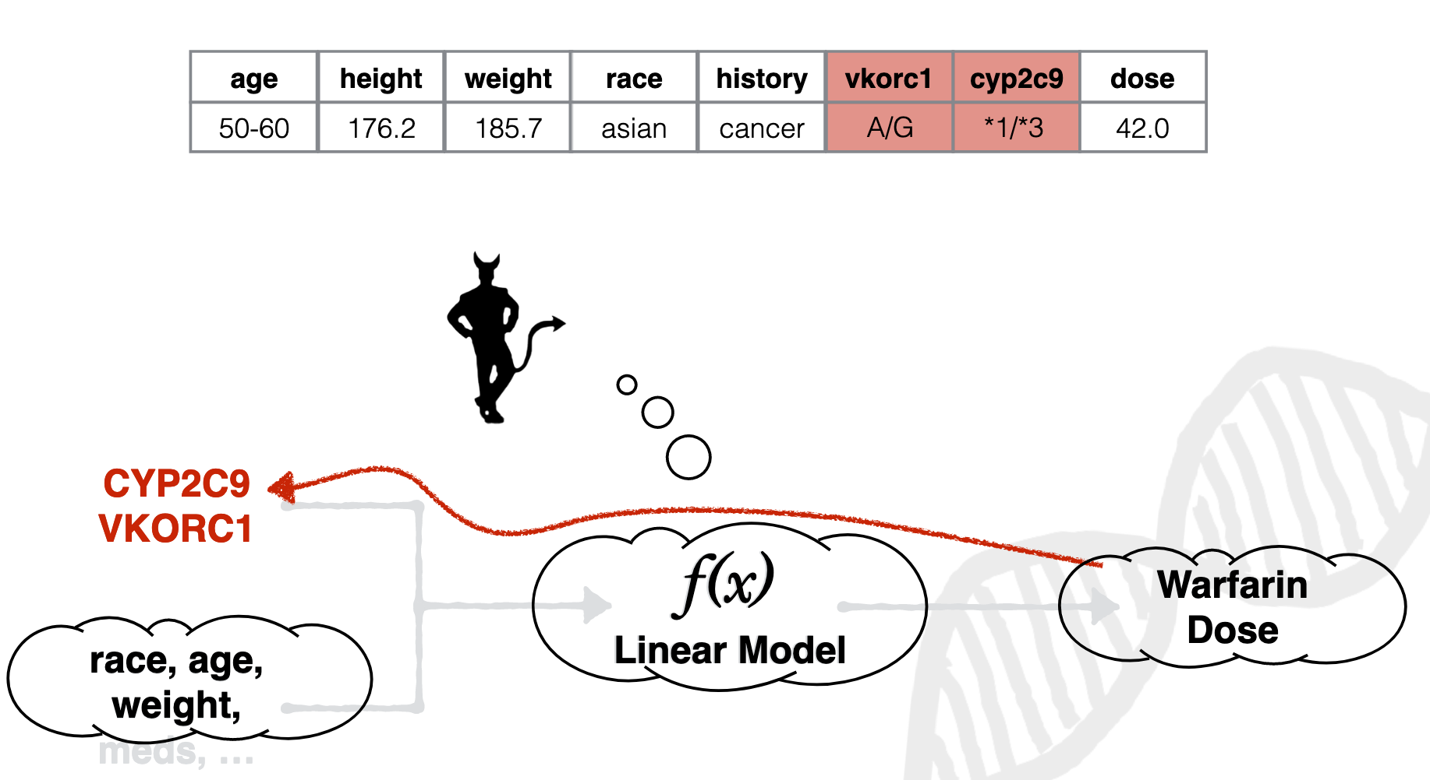
Pharmacogenetic Privacy
Can I predict

Slide 17
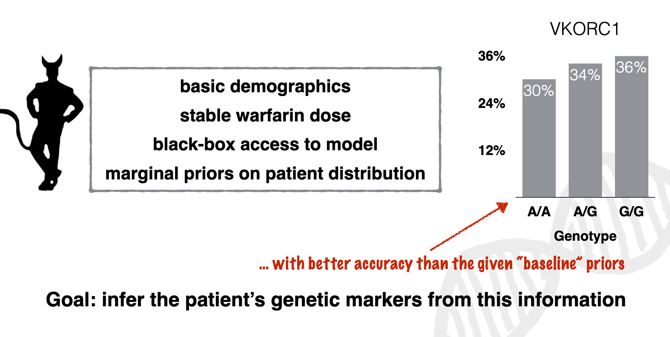
Model Inversion

Slide 18
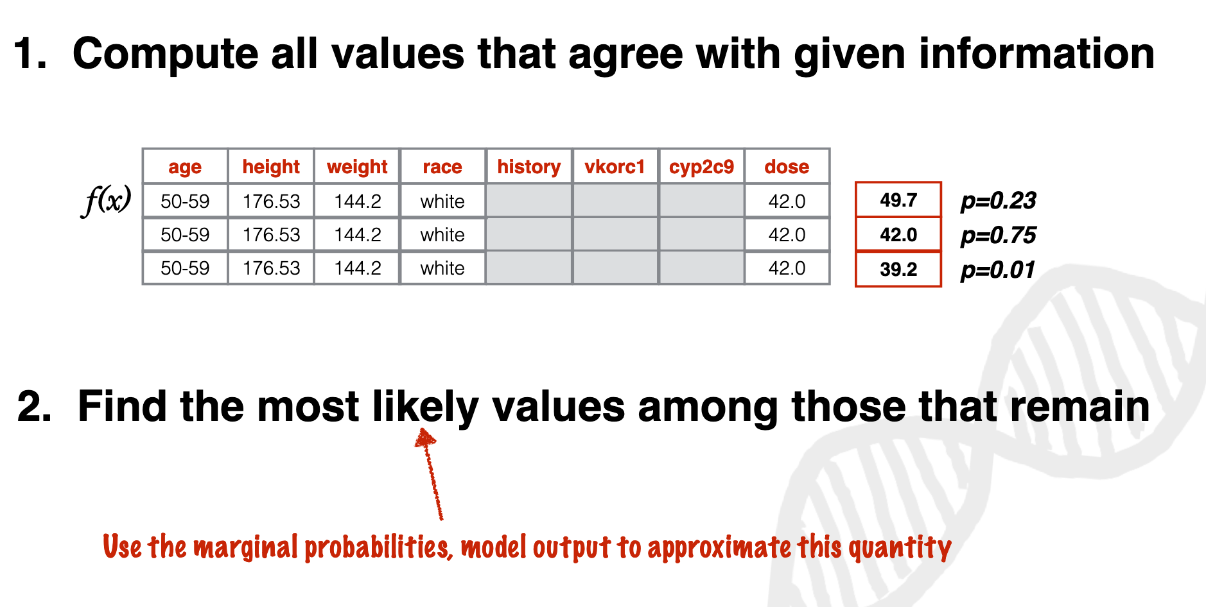
Model Inversion attack
Populate plausible values for unknown field and compute dose

Slide 19
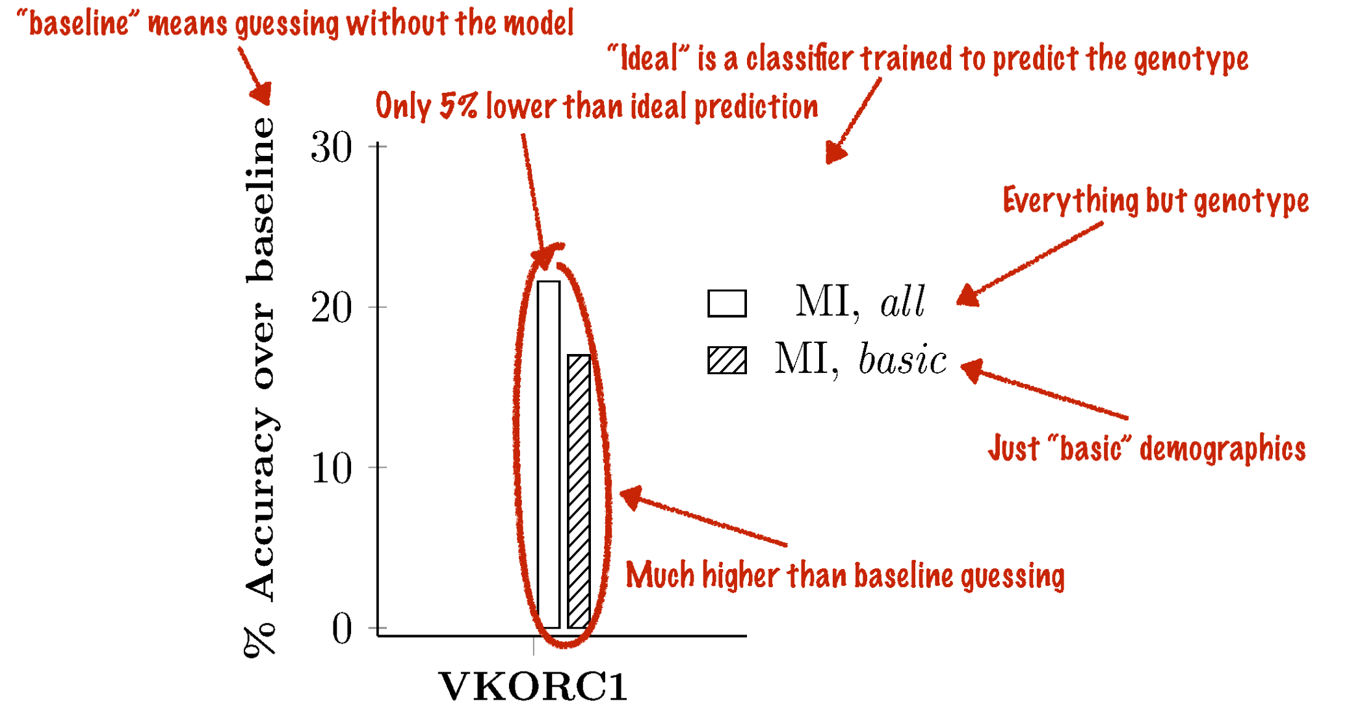
Results

Slide 20
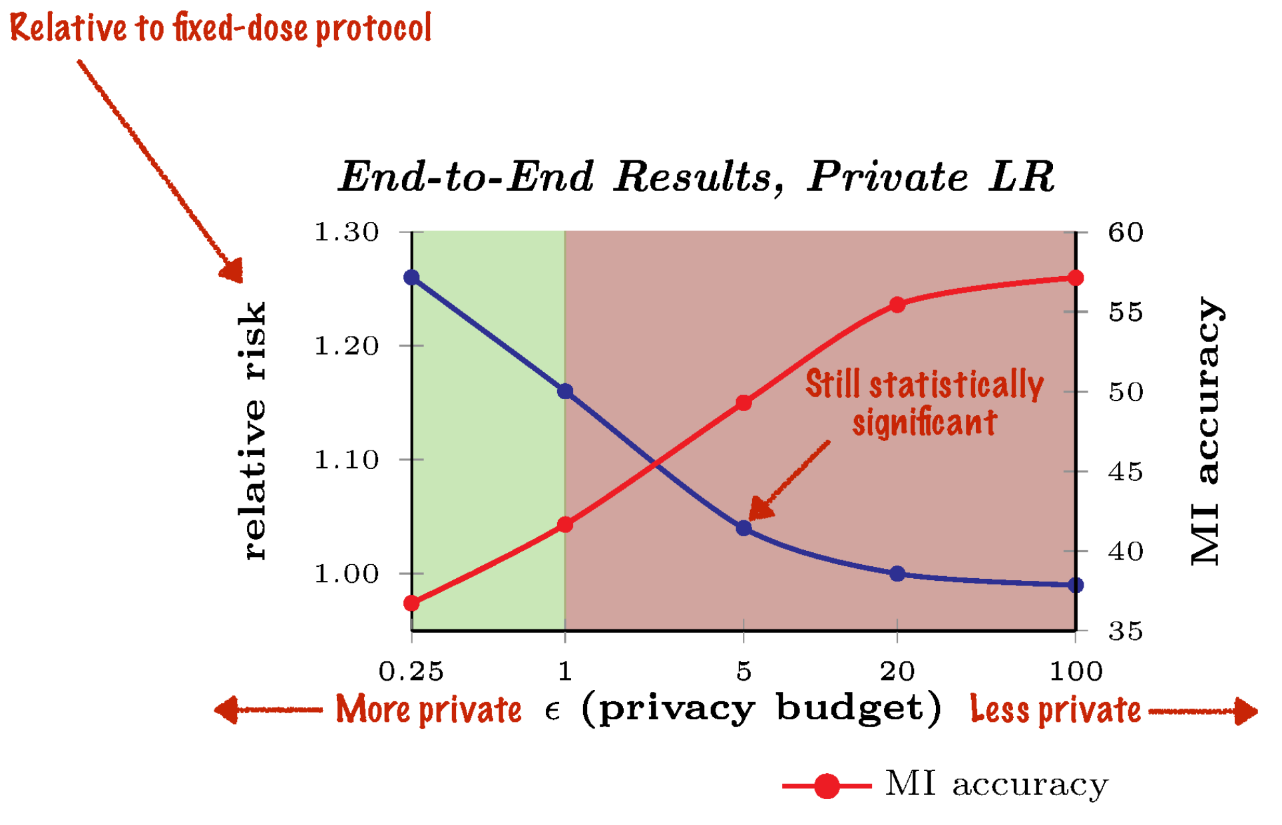
Any solution?
Differential Privacy!
This paper did not observe that a privacy budget significantly prevented model inversion without introducing risk over fixed dosing

Slide 21
Membership Inference

Slide 22
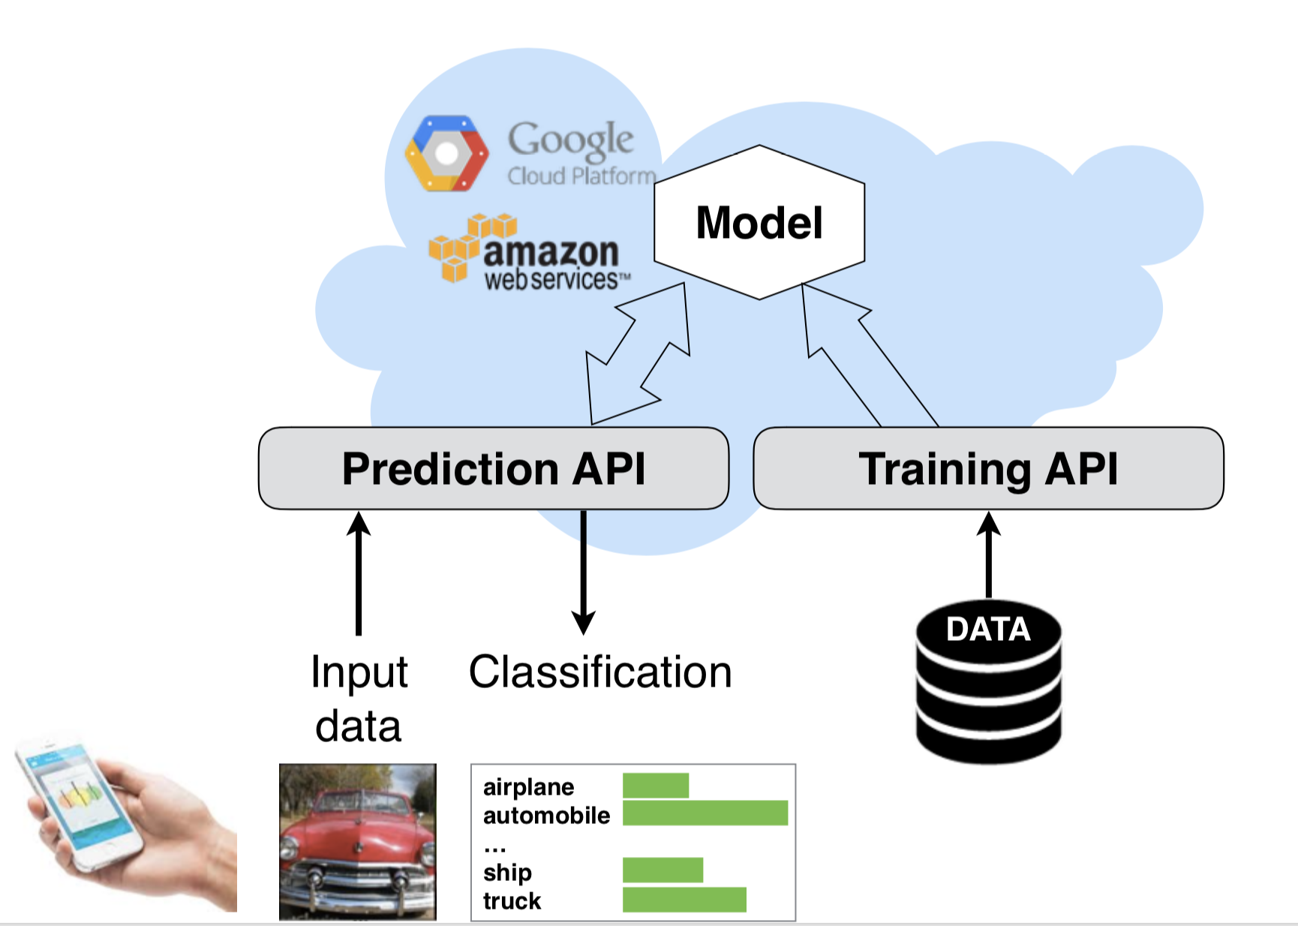
Machine Learning as a Service
Upload your data and magically get a trained model
Pay per query to the model
Model never revealed

Slide 23
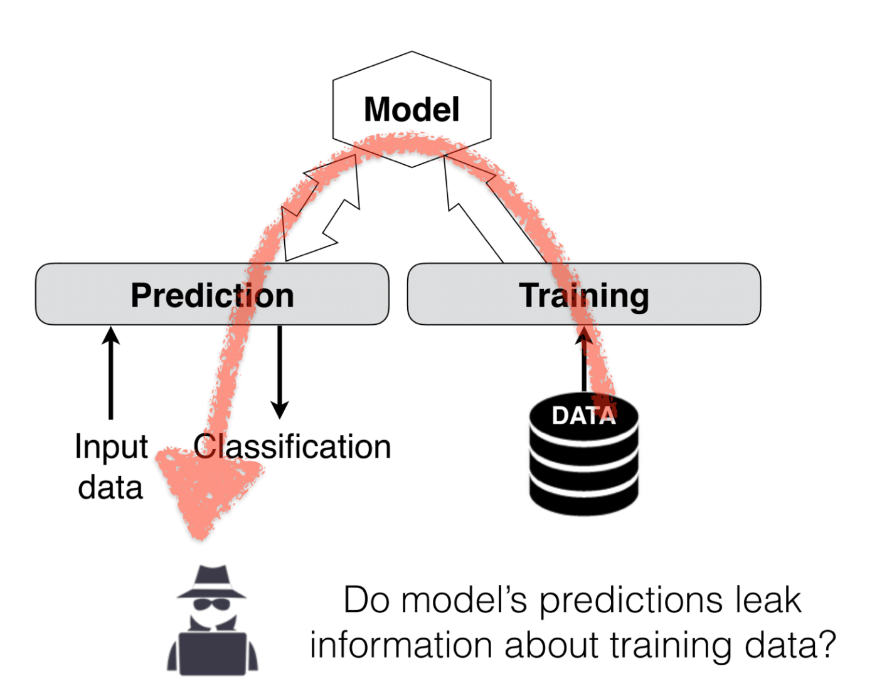
Machine Learning as a Service
Sensitive!
Transactions,
preferences,
online and offline behavior

Slide 24
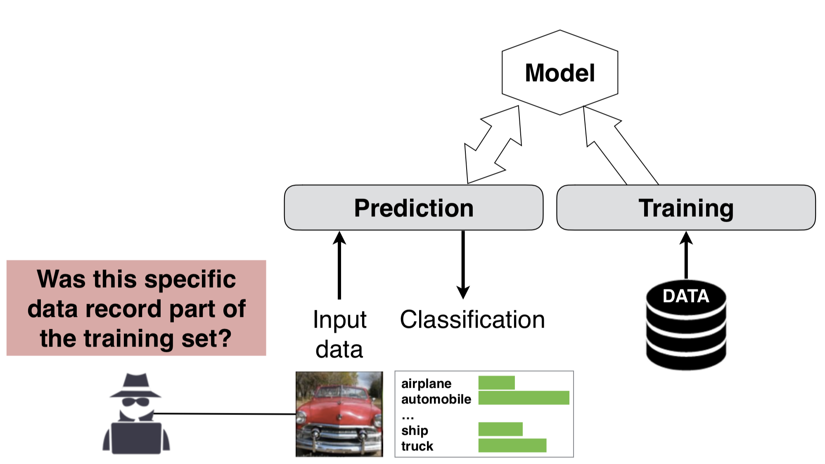
Membership inference attack

Slide 25

Why should we care about
membership inference attacks?

Slide 26
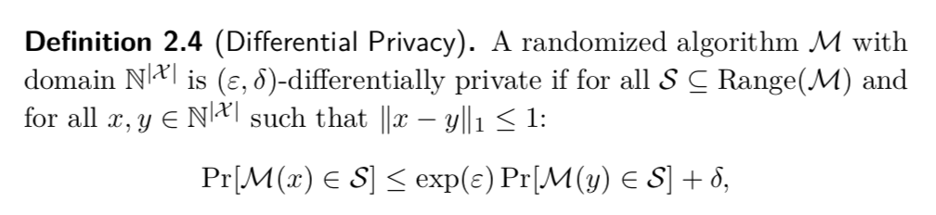
Differential Privacy
Any sequence of outputs is “essentially” equally likely to occur, independent of the presence or absence of any individual.

Slide 27
Differential Privacy v.s. Membership Privacy
Any sequence of outputs is “essentially” equally likely to occur, independent of the presence or absence of any individual.
Differential Privacy ~ Membership Privacy
[Li et al. 2013]

Slide 28
Membership Inference Attack on Summary Statistics
Summary statistics (e.g., average) on each attribute
Underlying distribution of data is known
[Homer et al. (2008)], [Dwork et al. (2015)], [Backes et al. (2016)]

Slide 29
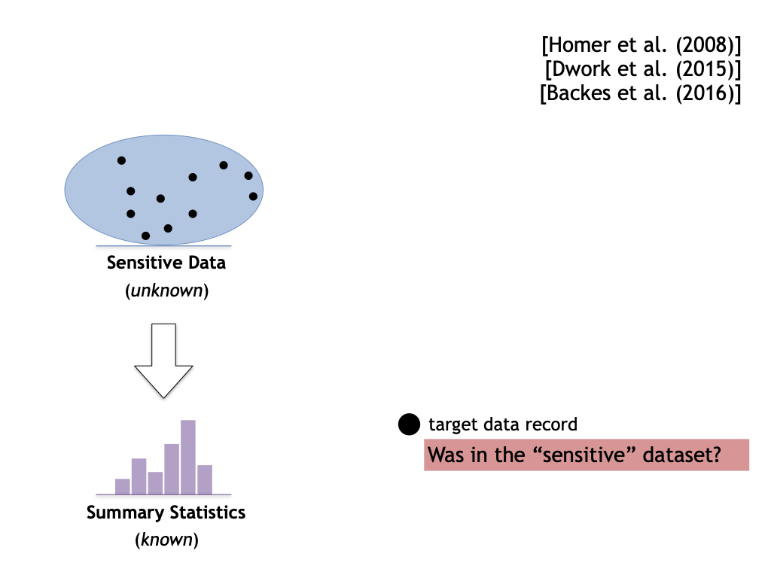
Membership Inference Attack

Slide 30
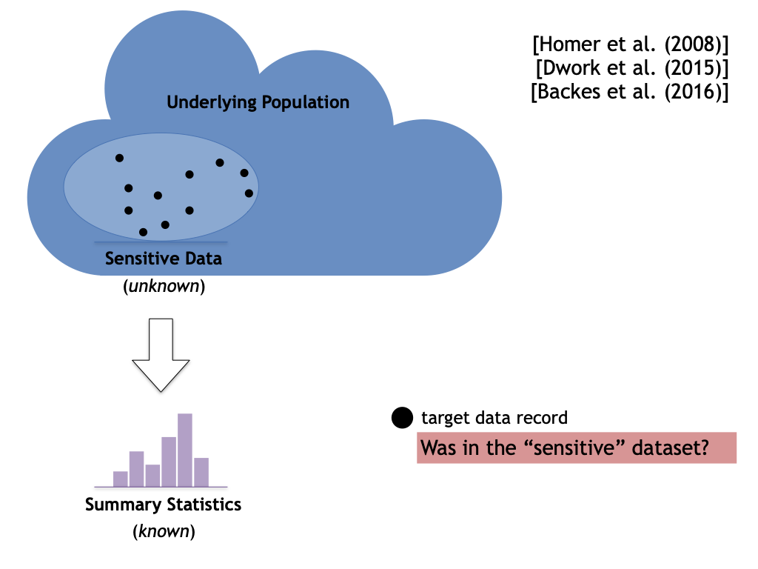
Membership Inference Attack

Slide 31
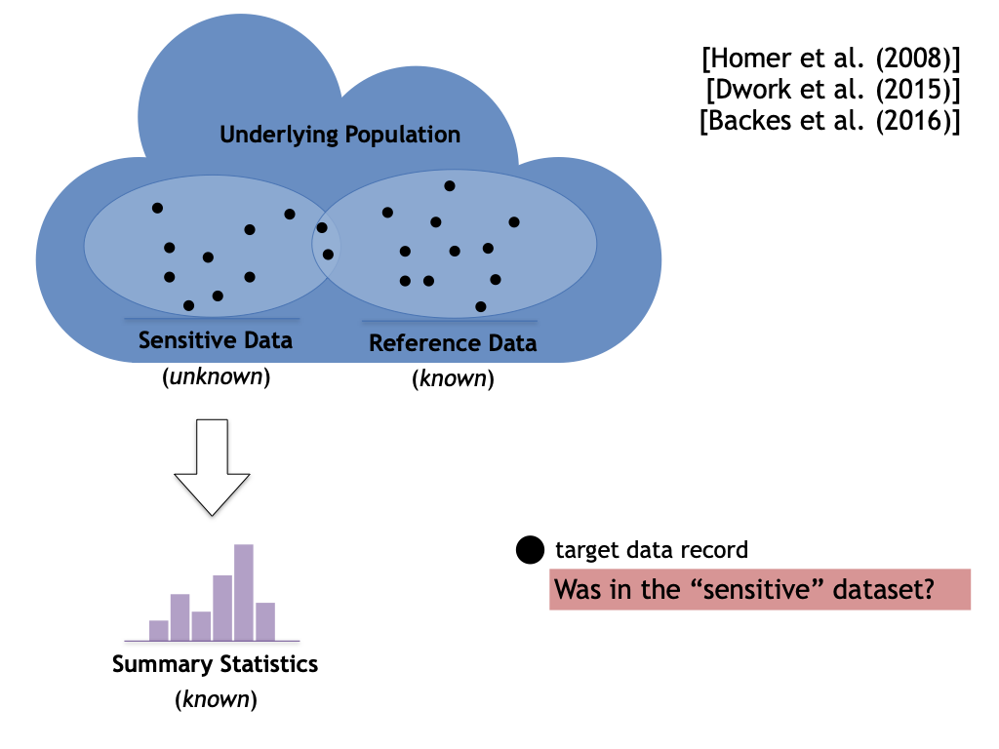
Membership Inference Attack

Slide 32
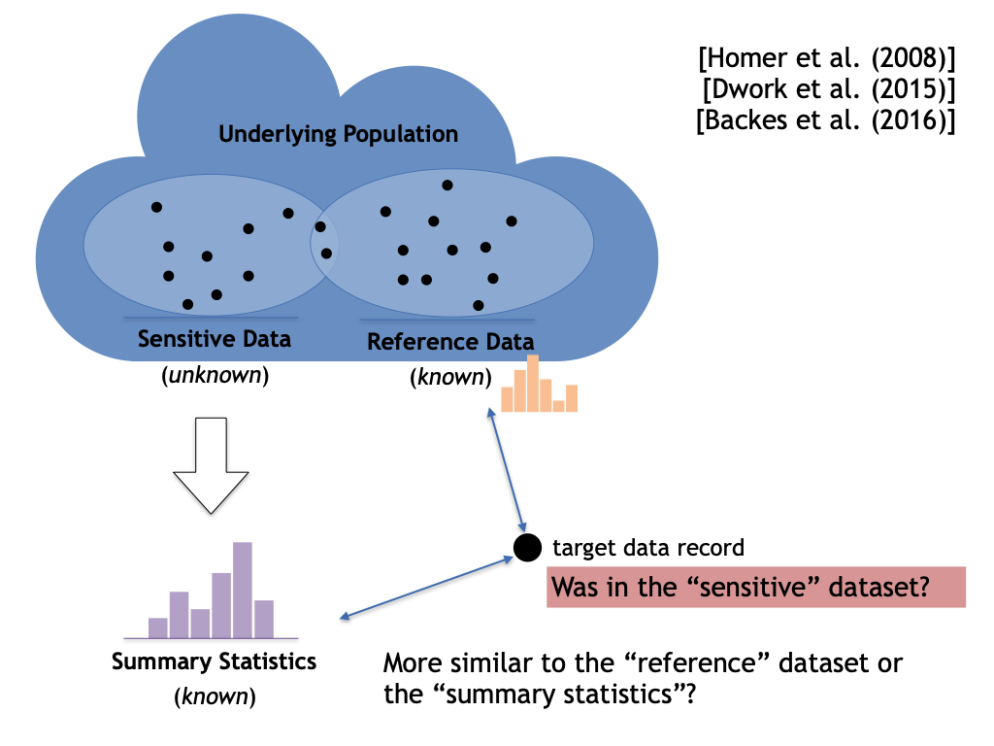
Membership Inference Attack
Remember: you have direct access to the summary statistics

Slide 33
Membership inference in ML is harder
Black-box setting:
No knowledge about the models’ parameters (distribution)
No access to internal computations of the model
No knowledge about the underlying distribution of data

Slide 34
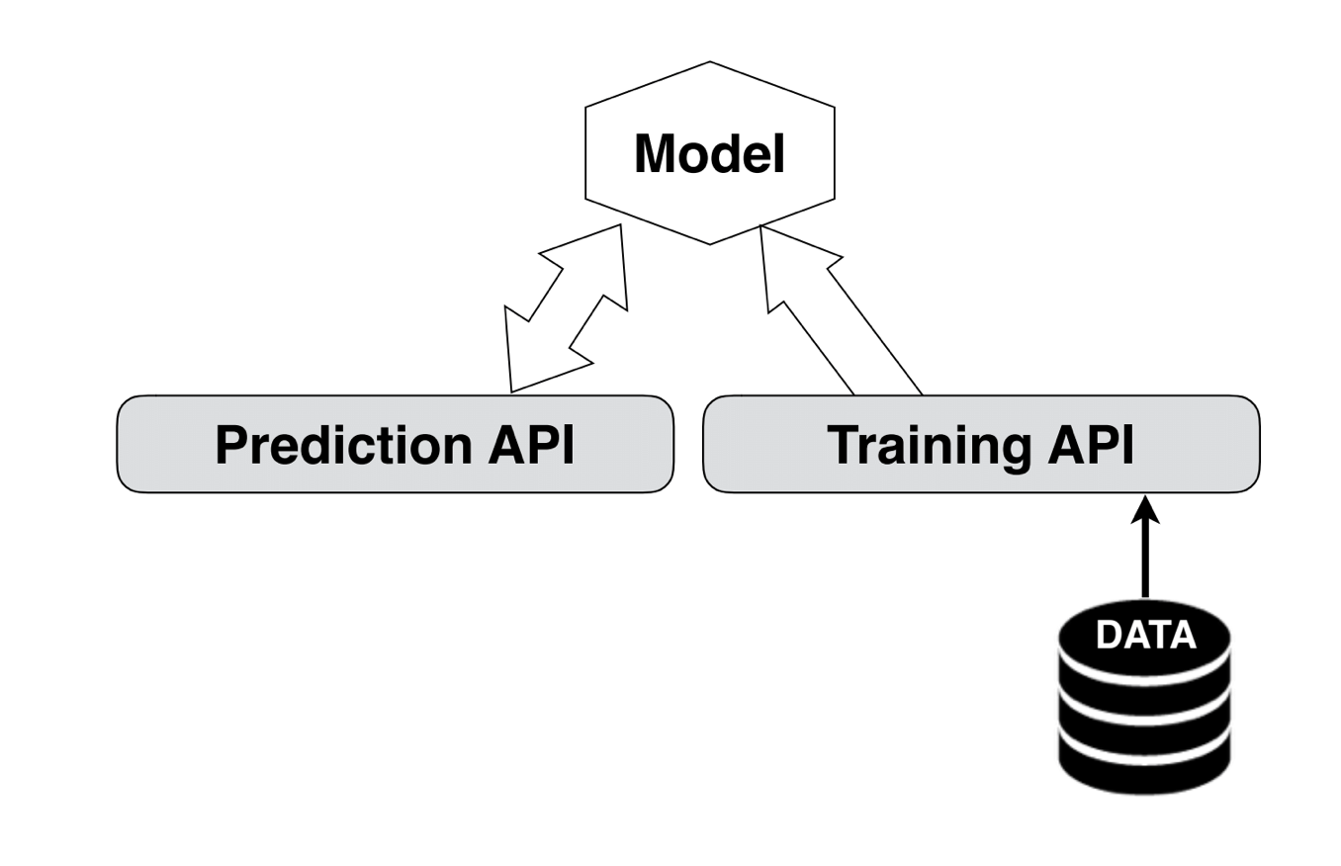
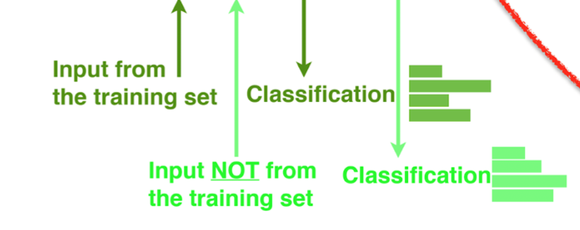
Exploit Model’s Predictions

Slide 35
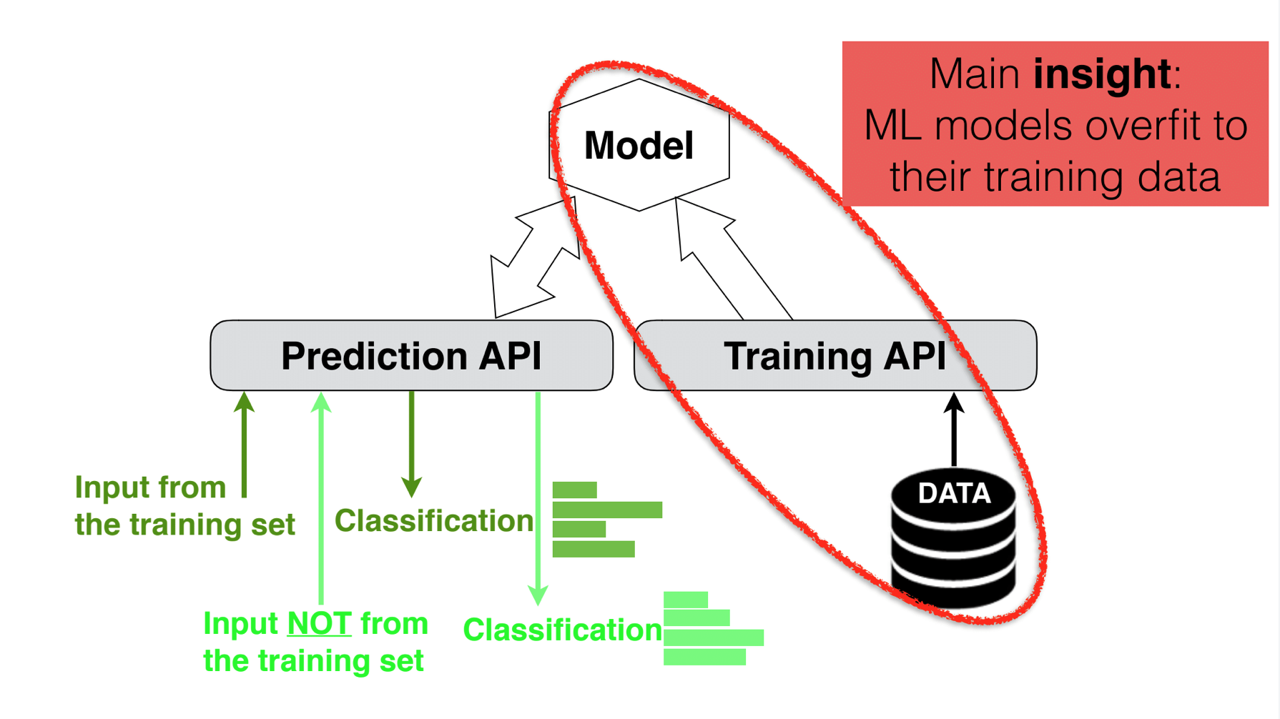
Attack Overfitted Models

Slide 36
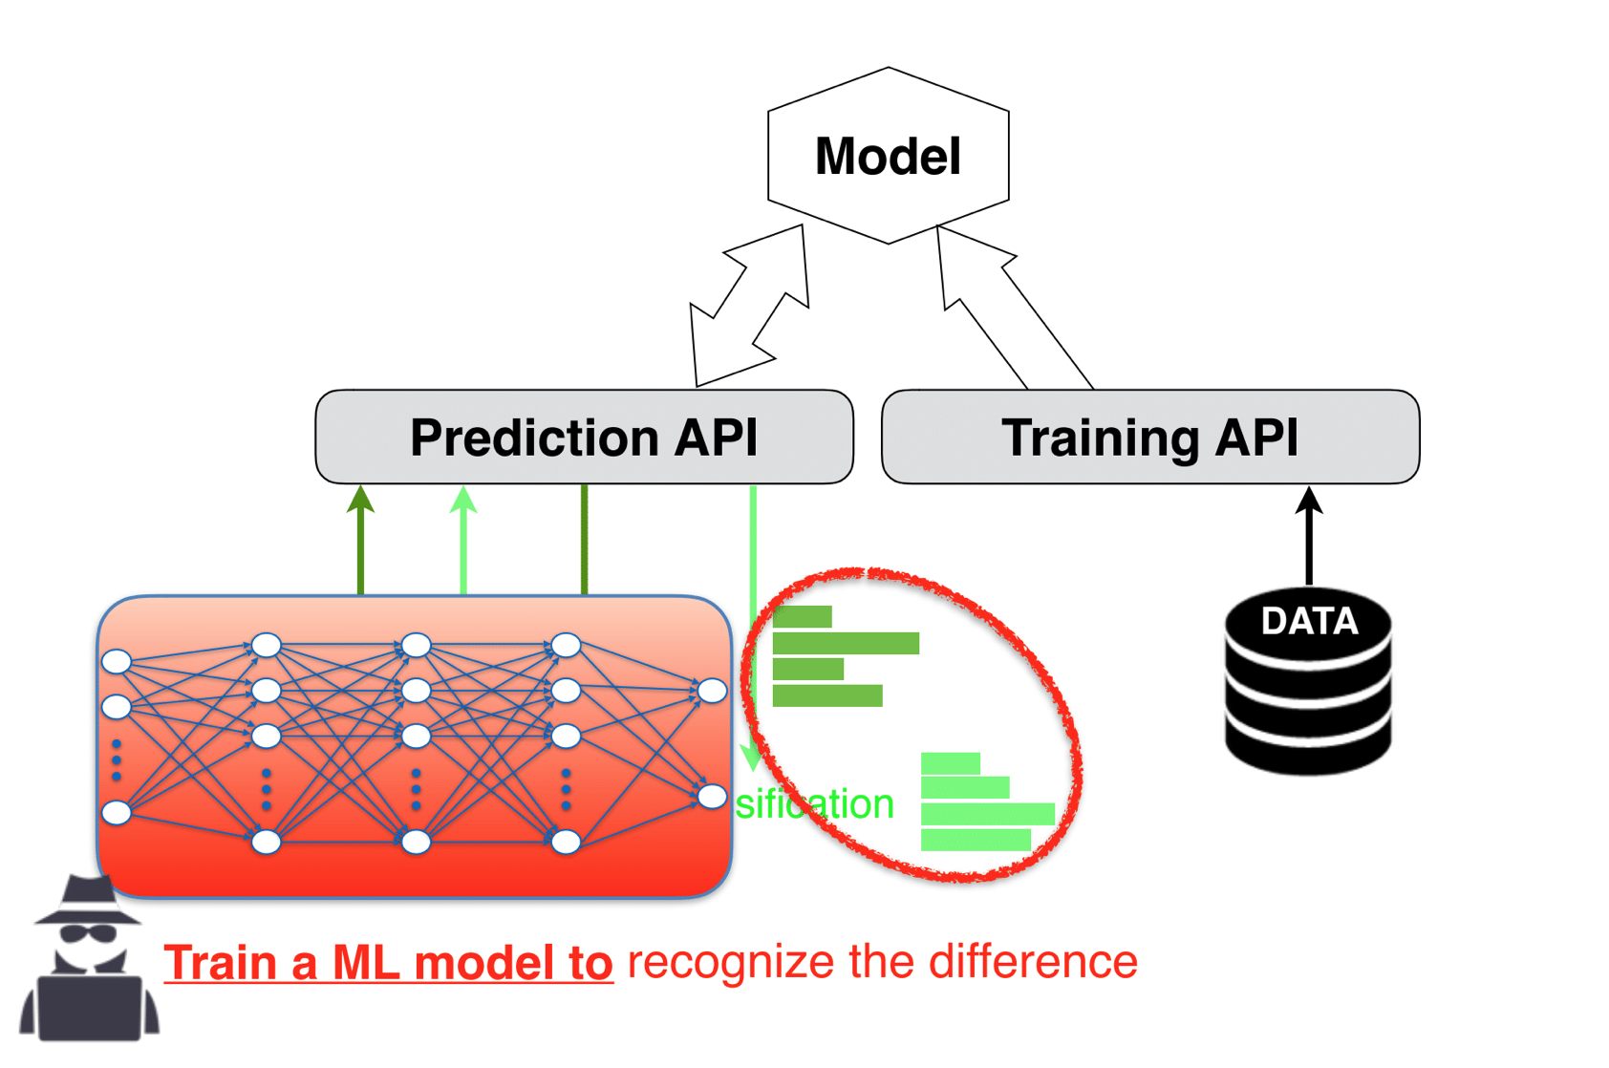
ML against ML

Slide 37
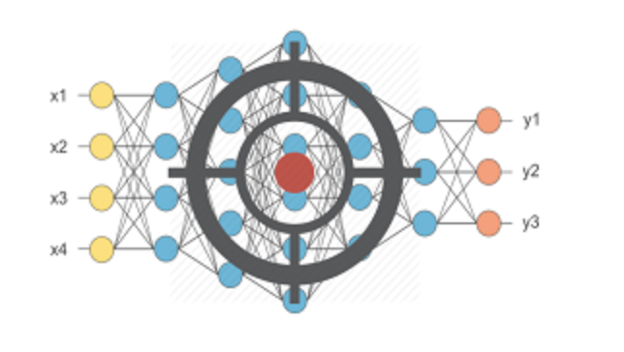
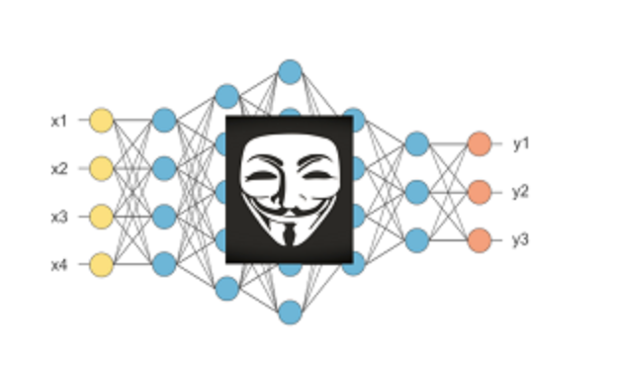
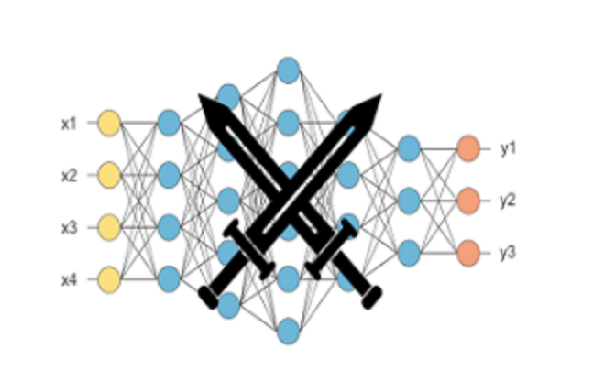
Different Models needed
Target Model (the one that a cloud service build’s):
Input: Data that you want to analyze
Output: Class prediction probability and final prediction
Shadow Model:
Input: Data from the same input distribution
Output: Class prediction probability and final prediction
Attack Model:
Input: class prediction probability
Output: member or not-member

Slide 38
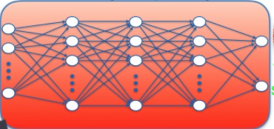
The Attack Model
Input: (original features, predicted class label, predictions by the target model)
e.g. (x₁, x₂, ..., x_{m}, y, p₁, p₂, ..., p_{k})
Output: in / out
x₁, x₂, ..., x_{m} = input vector
Y= output classification label
p₁, p₂, ..., p_{k} = prob. of each class label
How should we train the attack model?

Slide 39
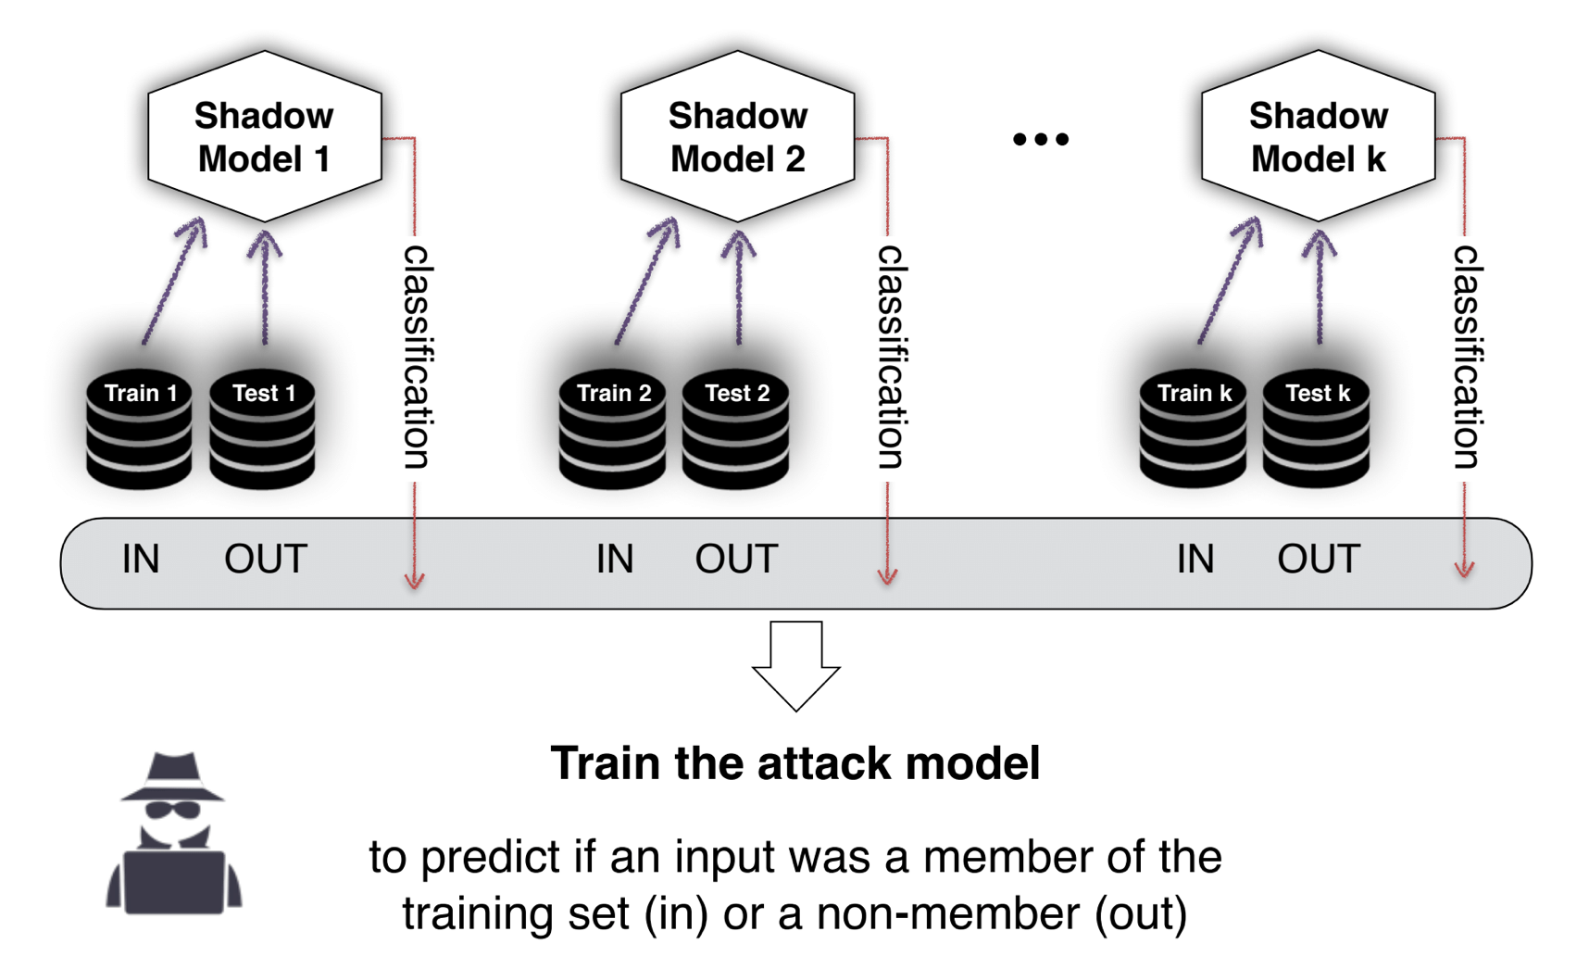
Shadow Models
Training data are sampled from the same distribution as the target training data
Have the same structure as the target model

Slide 40
Obtaining Training Data for Shadow Models
Real
Similar to training data of the target model (i.e., drawn from same distribution, if known)
Synthetic
Use a sampling algorithm to obtain data classified with high confidence by the target model

Slide 41
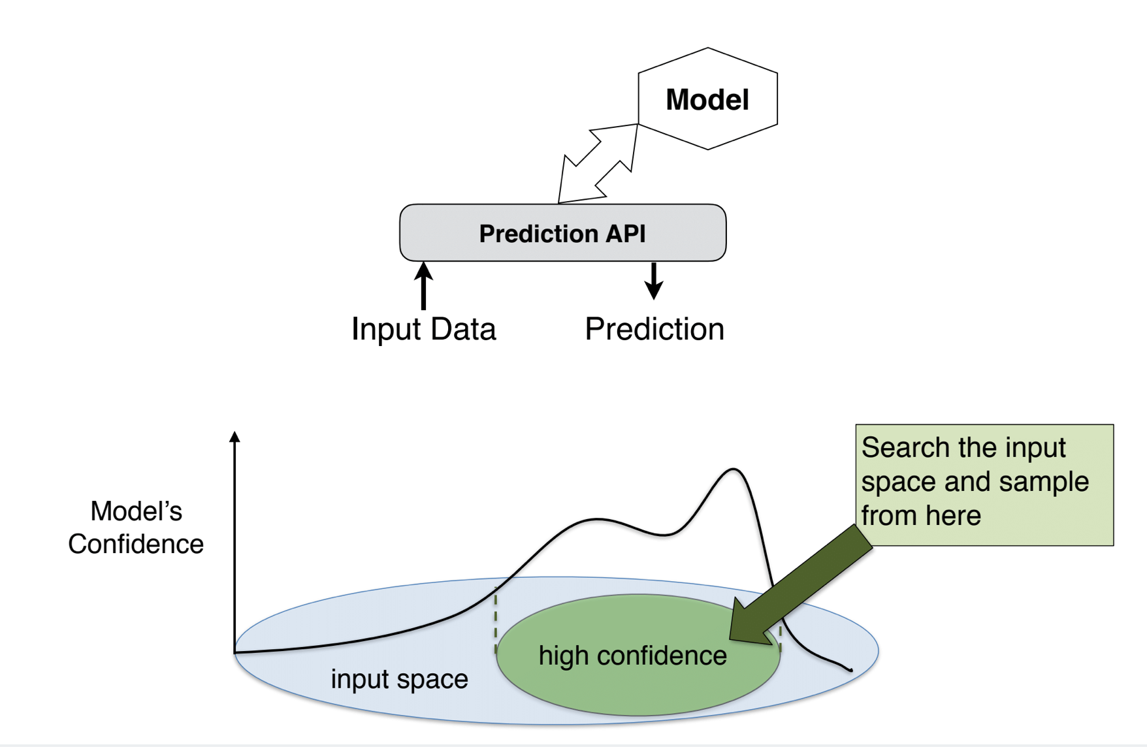
Synthesis using the target model
Target inputs

Slide 42
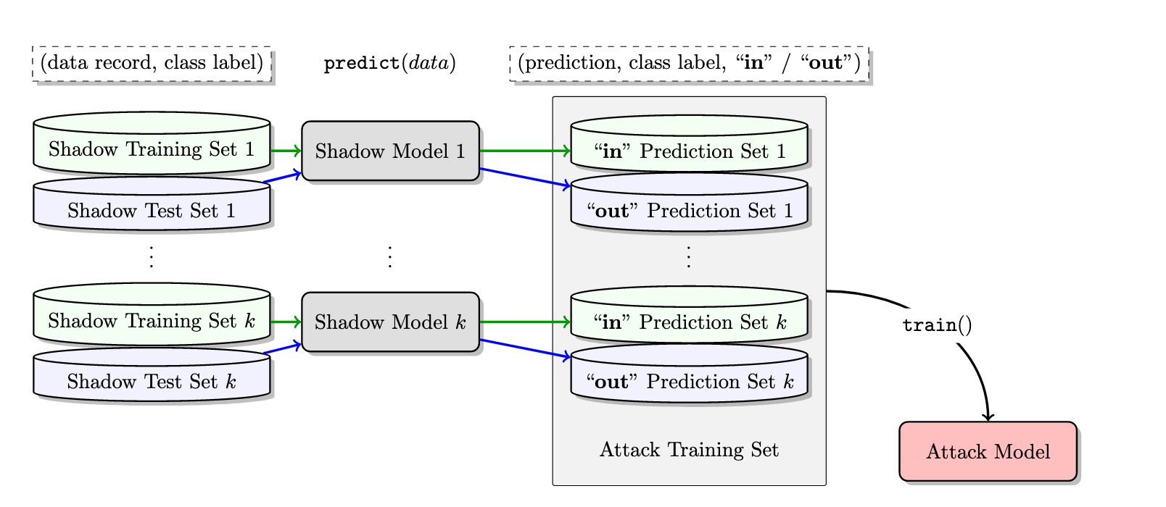
Shadow Models
Attack model training:
input feature output label
<prediction vector, class label> <in or out>
Prediction vector: [<prob., class label, confidence> …]

Slide 43
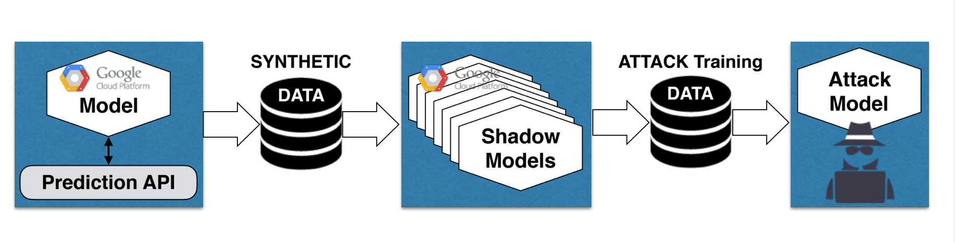
Constructing the Attack Model
Step 1: Generate Synthetic Data
Step 2: Train Shadow Models
Step 3: Train the Attack Model
Membership Inference Attacks Against Machine Learning Models. Reza Shokri ; Marco Stronati ; Congzheng Song ; Vitaly Shmatikov IEEE SP 2017

Slide 44
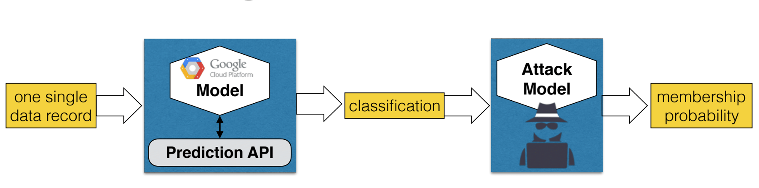
Using the Attack Model
Step 1: Get the prediction vector on the target record
Step 2: Get the prediction of the attack model

Slide 45
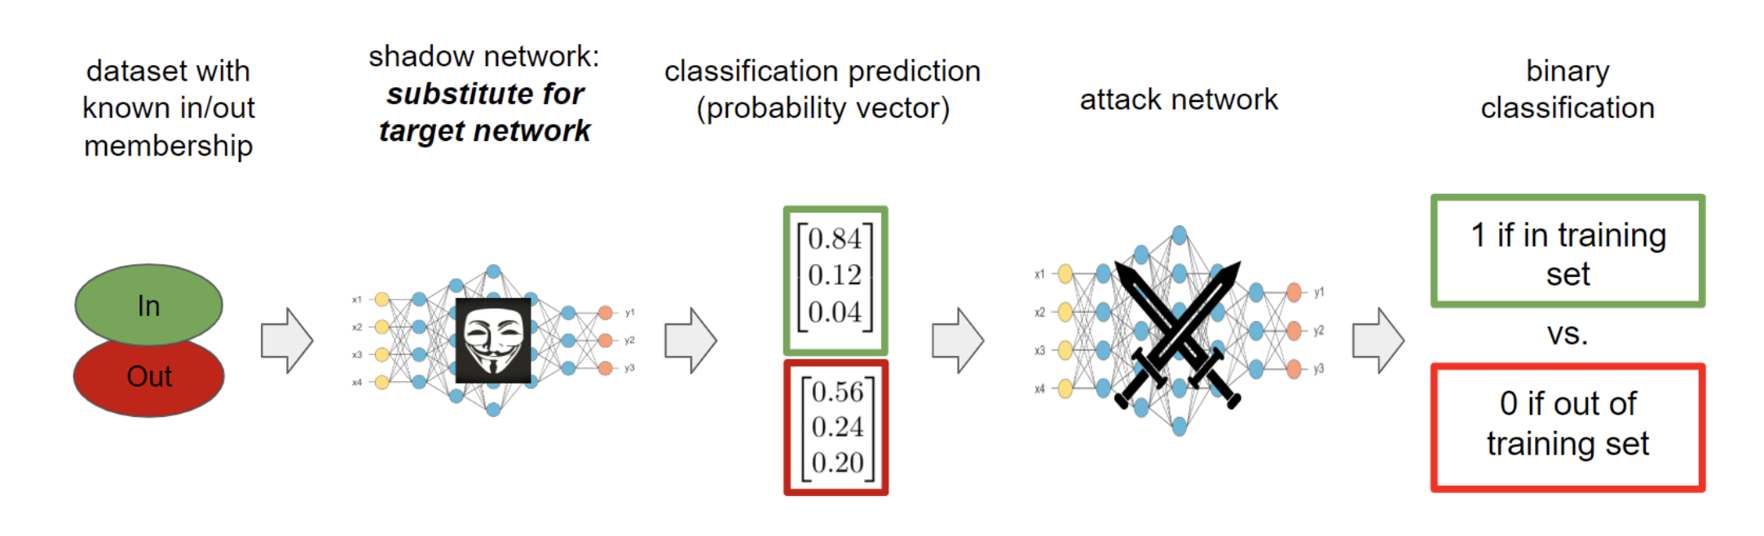
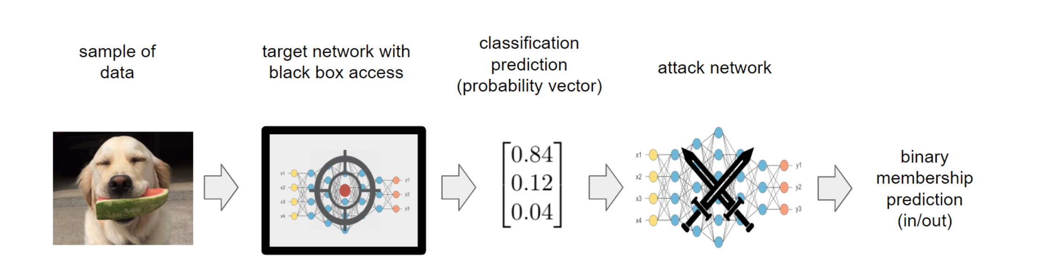
Another illustration

Slide 46
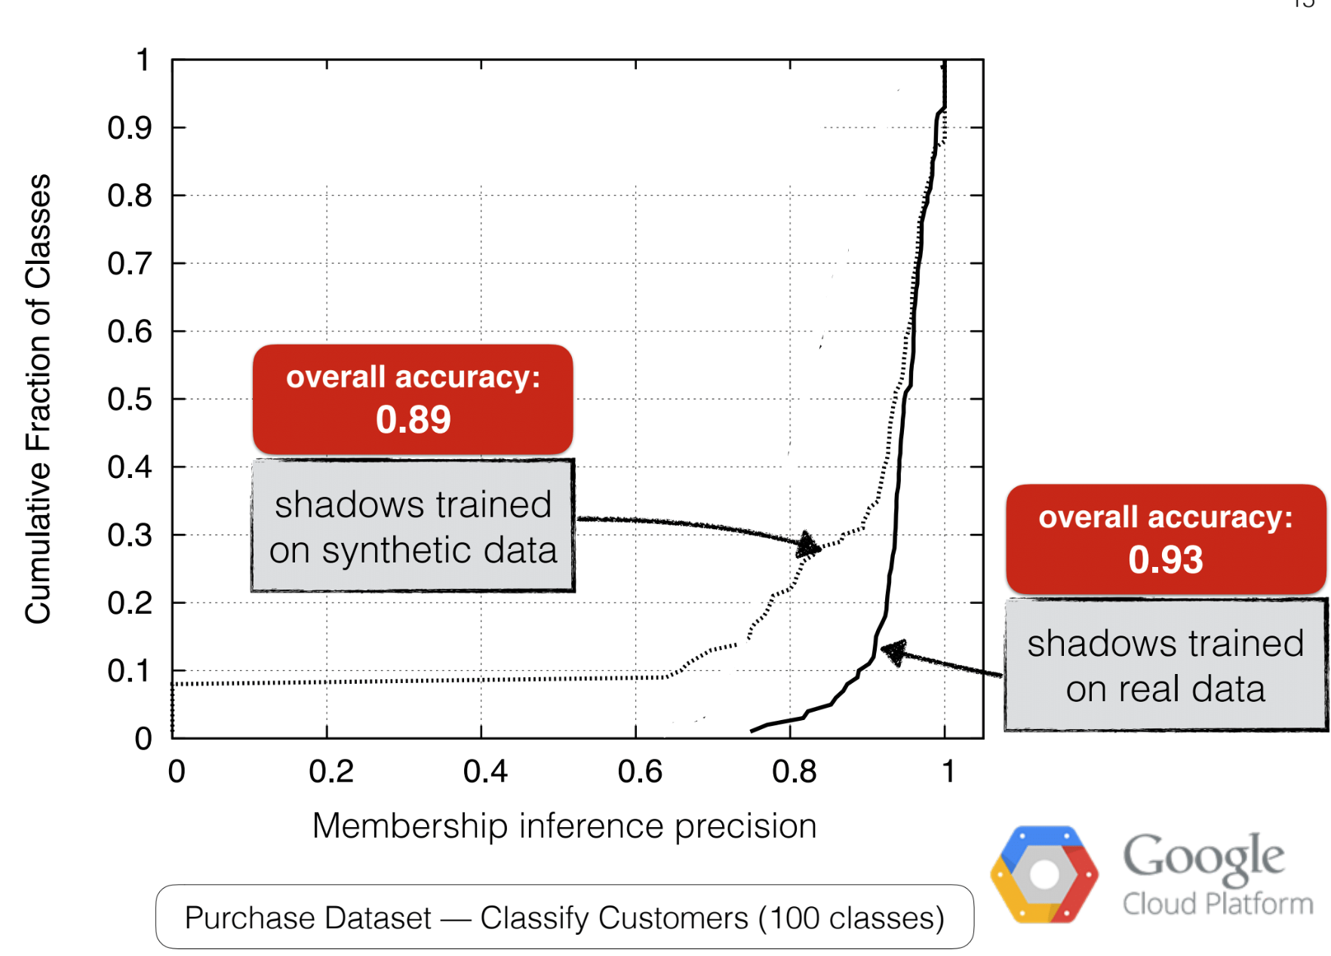
Attack Performance

Slide 47
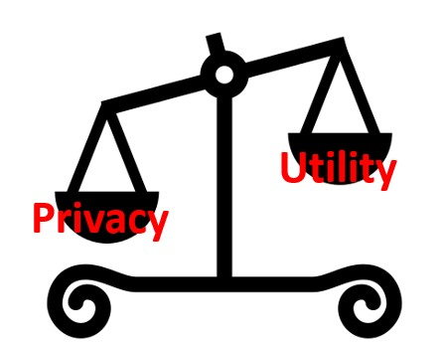
Typical privacy- utility tension
Utility: release aggregate statistics
Privacy: ??? (intuition: individual’s membership stays “hidden”)
If we add too much noise utility suffers
If don’t add noise deidentification is possible

Slide 48
How is the scenario with ML?
Don’t want any information about an individual leaking
The model should generalize outside the training set
Overfitting is the common enemy!

Slide 49
Takeaway
Modern machine learning is both a threat and an opportunity for data privacy
For once, privacy and utility are not in conflict: overfitting is the common enemy
Overfitted models leak training data
Overfitted models lack predictive power
Need generalizability and accuracy

Slide 50
Logistics
Project progress report due today @11:59pm.
Homework 3 due Oct 8 @11:59pm.

